Slide 1
go build & go install
review

Slide 2
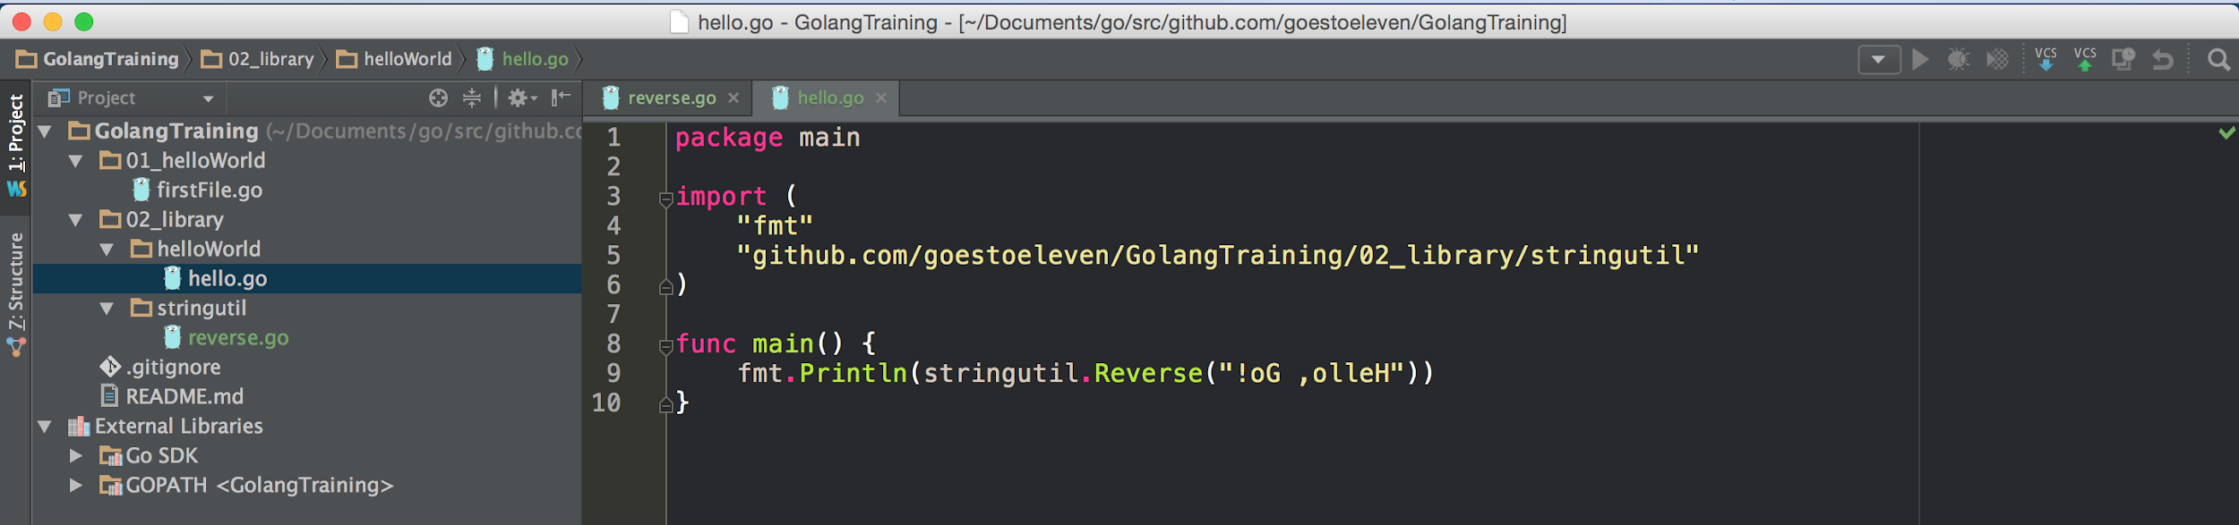
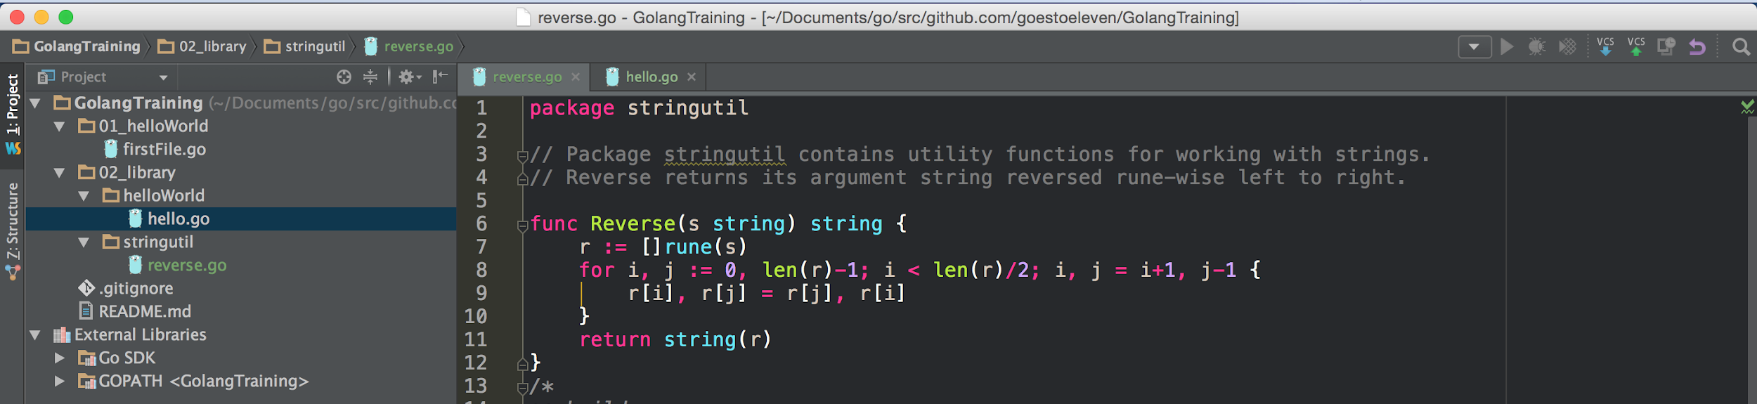
two packages and two files from before ...

Slide 3
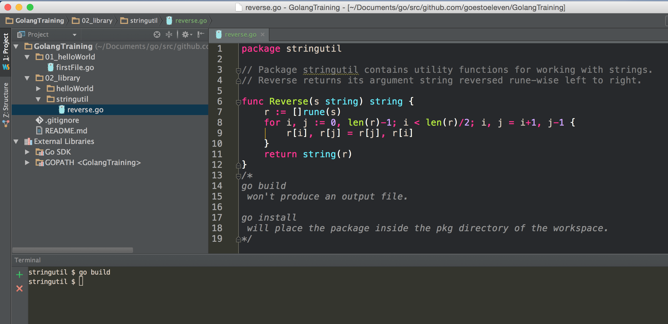

Slide 4
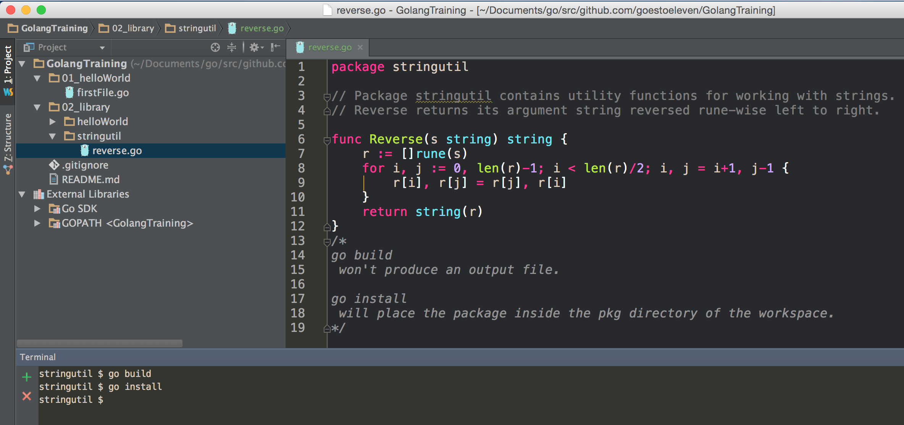

Slide 5
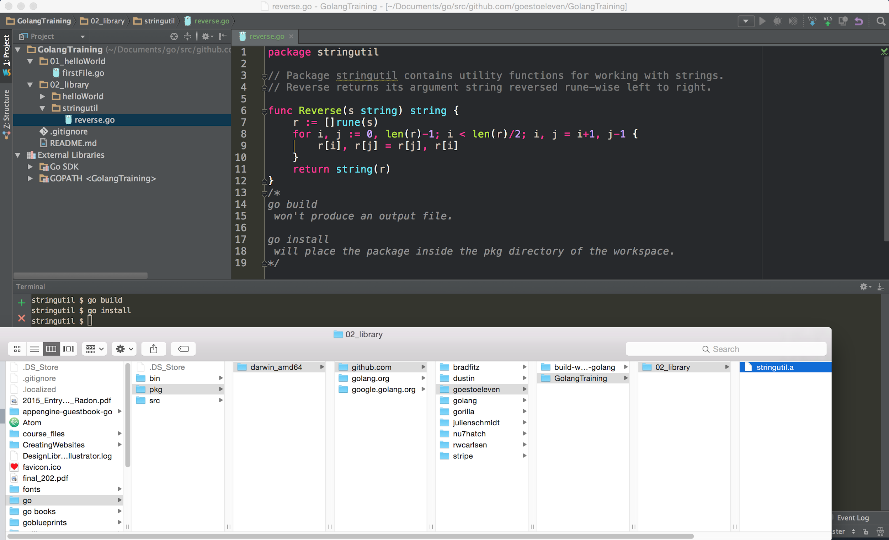

Slide 6
import

Slide 7
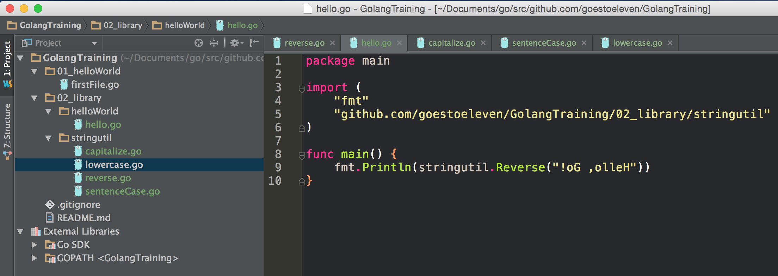
Notice how we import a package ...

Slide 8
Notice how we import a package ...
… and then use one of its public funcs.

Slide 9
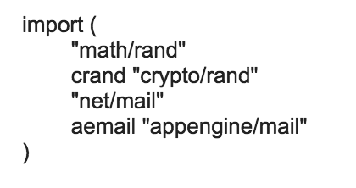
Aliasing Imports

Slide 10
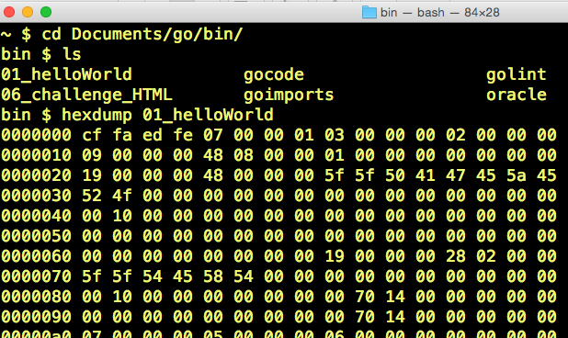
just for fun

Slide 11
Review
go build
builds go code; if code is package main, it creates a binary executable and drops it in the package main’s folder; if code is just a package, it builds it then throws away the binary.
go install
builds and installs go code; if code is package main, it creates a binary executable and drops it in the workspace’s bin folder; if code is a package, it builds it then drops it in the pkg folder (a file with a .a extension)
import
import path is everything after the “src” folder in your workspace
use the last folder in the import path to reference the package in your code
you can alias packages in your imports

Slide 12
Review Questions

Slide 13
import
Search for uuid at godoc.org
use go get to get the code for nu7hatch/gouuid
open up finder
locate this code
take a screenshot of this
Create a file that imports this code
alias the package as just uuid
take a screenshot of this

